Slide 1
MLOPs Using MLflow
Nagaraj Sengodan
Senior Technical Manager, HCL Technologies
Nitin Raj Soundararajan
Technical Consultant, Cognizant Worldwide Limited

Slide 2


Presenter
Nagaraj Sengodan is a Senior Technical Manager in Data and Analytics Practice at HCL Technologies.
Nitin Raj Soundararajan is a technical consultant focusing on advanced data analytics, data engineering, cloud scale analytics and data science.

Slide 3
Agenda
MLOps
MLOps Process and stages.
Challenges
MLFlow
Components
Mapping with MLOps stages
Demo
Real-world example for mlflow
Q & A

Slide 4
MLOps

Slide 5
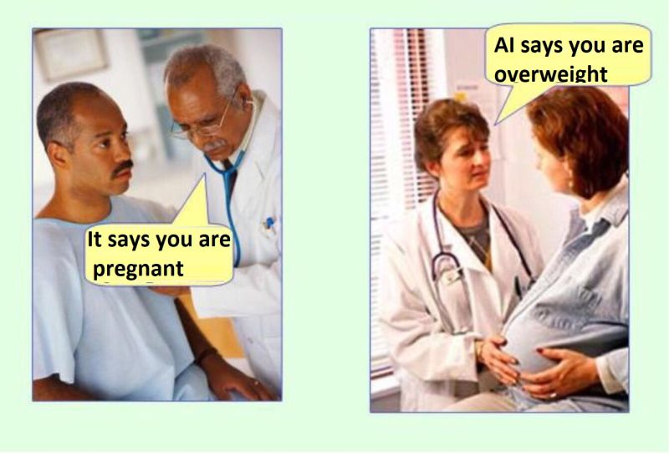
Why

Slide 6
Challenges
Reproducibility in ML models
ML Operations
Model Management
Tools and Technologies

Slide 7
MLOps
How we deploy software
Software took months to release; now it releases daily.
Software
Engineering
DevOps
Write
Deploy
How we write software
MLOps
Evolution of Software Engineering from punch card to Distributed version control… Github!
ML Engineer
Train
How we use data + maths to train models
From curve fitting to neural networks…
Notes:
Communication between data scientist, operations or production team.
Collaborative in nature.
Designed to eliminate waste, automate as much as possible, produce richer, consistent insights.
MLOps follows a similar pattern to DevOps.
MLOps drives insights you can trust and put into play more quickly.

Slide 8





Collaboration in Nature
Data Pipeline
Modelling Pipeline
PREPARE DATA
TRAIN MODEL
Data Repository
FEATURE
TRAIN
EVALUATE
Data Scientist
Release Pipeline
RELEASE MODEL
Model Registry
Data Engineer
Collect
DEPLOY
APPROVE
PROFILE
VALIDATE
PACKAGE
Data Source
ML Engineer
Notes:
Communication between data scientist, operations or production team.
Collaborative in nature.
Designed to eliminate waste, automate as much as possible, produce richer, consistent insights.
MLOps follows a similar pattern to DevOps.
MLOps drives insights you can trust and put into play more quickly.

Slide 9
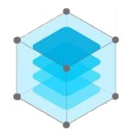

MLOps – Life-Cycle
ML Orchestration
ML Health
Business Impact
Model Governance
CI / CD
Machine Learning Models
Collaboration
MLOps
Productionizing Machine Learning Models
Business Value
Collaboration
Notes:
Communication between data scientist, operations or production team.
Collaborative in nature.
Designed to eliminate waste, automate as much as possible, produce richer, consistent insights.
MLOps follows a similar pattern to DevOps.
MLOps drives insights you can trust and put into play more quickly.

Slide 10
Life Cycle
Software
Coding
Unit Test Cases
Peer –Review
Approval
Commit
Test Release
Prod Release
Writing Code for specific requirement / functionality
Writing Unit test cases for each functionality and block to cover all boundary condition
Peer review the code and make sure code meets the standard and best practices
Code is approved to check-in to repository / version control
Approved code is merged with main / feature branch for release rollover.
Release the feature / main branch for Testing.
Move the Tested version to production.

Slide 11
Life Cycle
Software
ML
Coding
Unit Test Cases
Peer –Review
Approval
Commit
Test Release
Prod Release
Analyse Data
Data Preparation
Building Model
Evaluate the Model
Deploy Model
Monitor and Re-Train
Model Optimization

Slide 12
Life Cycle
Software
ML
GOAL
Coding
Unit Test Cases
Peer –Review
Approval
Commit
Test Release
Prod Release
Cover Functional Requirements
Optimize Metrics
Analyse Data
Data Preparation
Building Model
Evaluate the Model
Deploy Model
Monitor and Re-Train
Model Optimization

Slide 13
Life Cycle
Software
ML
GOAL
Coding
Unit Test Cases
Peer –Review
Approval
Commit
Test Release
Prod Release
Cover Functional Requirements
Optimize Metrics
Analyse Data
Data Preparation
Building Model
Evaluate the Model
Deploy Model
Monitor and Re-Train
Model Optimization
QUALITY
Depends on the Code
Depends on Data, Choice of algorithm, params, etc…

Slide 14
Life Cycle
Software
ML
GOAL
Coding
Unit Test Cases
Peer –Review
Approval
Commit
Test Release
Prod Release
Cover Functional Requirements
Optimize Metrics
Analyse Data
Data Preparation
Building Model
Evaluate the Model
Deploy Model
Monitor and Re-Train
Model Optimization
QUALITY
Depends on the Code
Depends on Data, Choice of algorithm, params, etc…
TECHNOLOGY
Mostly one tech stack
Combinations of many libraries and tools

Slide 15
Life Cycle
Software
ML
GOAL
Coding
Unit Test Cases
Peer –Review
Approval
Commit
Test Release
Prod Release
Cover Functional Requirements
Optimize Metrics
Analyse Data
Data Preparation
Building Model
Evaluate the Model
Deploy Model
Monitor and Re-Train
Model Optimization
QUALITY
Depends on the Code
Depends on Data, Choice of algorithm, params, etc…
TECHNOLOGY
Mostly one tech stack
Combinations of many libraries and tools
OUTCOME
Works deterministically
Changing based on data…
Notes:
Devops - MLOps

Slide 16
MLOps <<Need to revisit the title>>
ML Health
Business Impact
Model Governance
CI / CD
ML Orchestration
Machine Learning Models
Collaboration
MLOps
Productionizing Machine Learning Models
Business Value
Collaboration
Notes:
Data should always have business focus.
MLOps merges the expertise of operations team has the business knowledge and your data science team understands the data for more efficient ML that leverages both sets of skills.
The regulatory side of operations is a critical function. MLOps puts your operations team at the forefront of new regulations and best practices.

Slide 17

A platform for the Complete Machine Learning Lifecycle

Slide 18


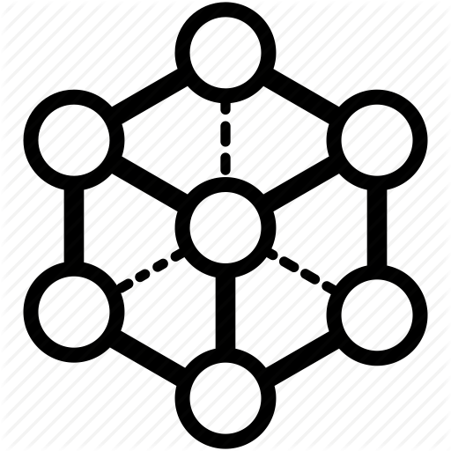
MLFlow Components
MLflow Tracking - Record and query experiments: code, data, config, and results
MLflow Projects - Package data science code in a format to reproduce runs on any platform
Machine Learning lifecycle
MLflow Models - Deploy machine learning models in diverse serving environments
MLflow Registry - Store, annotate, discover, and manage models in a central repository

Slide 19

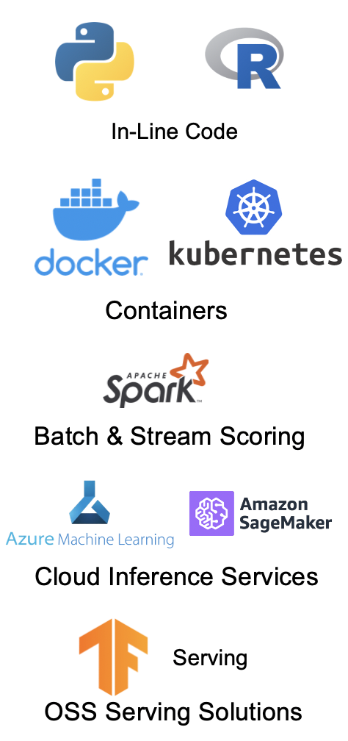
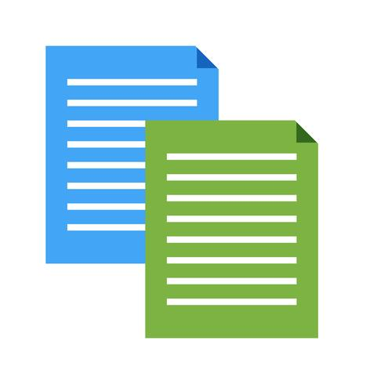
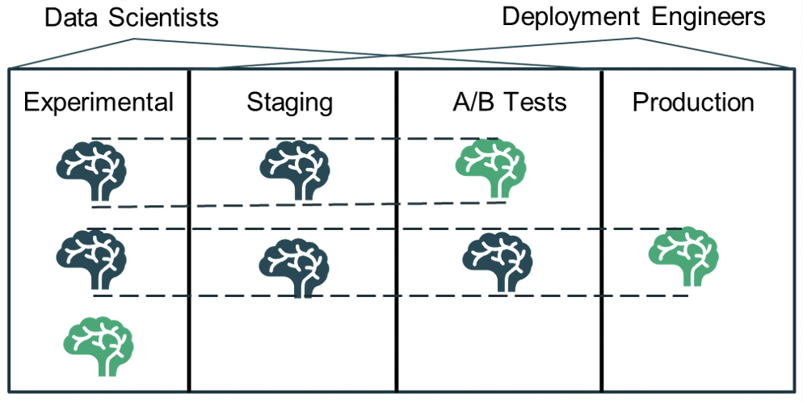
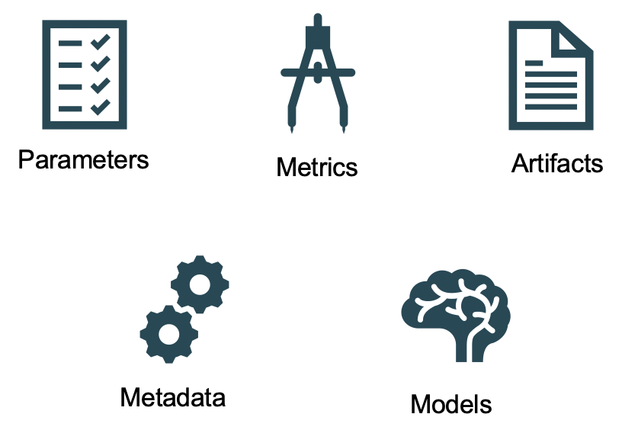
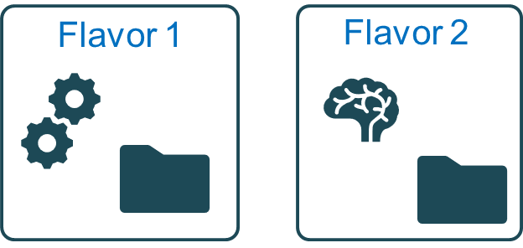
Mlflow Workflow
Model Registry
V0
Models
Tracking
V1
V1
V2
V3

Slide 20















Mlflow Tracking
Tracking Server
UI
Notebooks
Parameters
Metrics
Artifacts
Local Apps
API
Cloud Jobs
Metadata
Models
Spark Data Source

Slide 21


Mlflow Projects
Project Spec
Local Execution
Code
Metadata
Remote Execution
Config

Slide 22
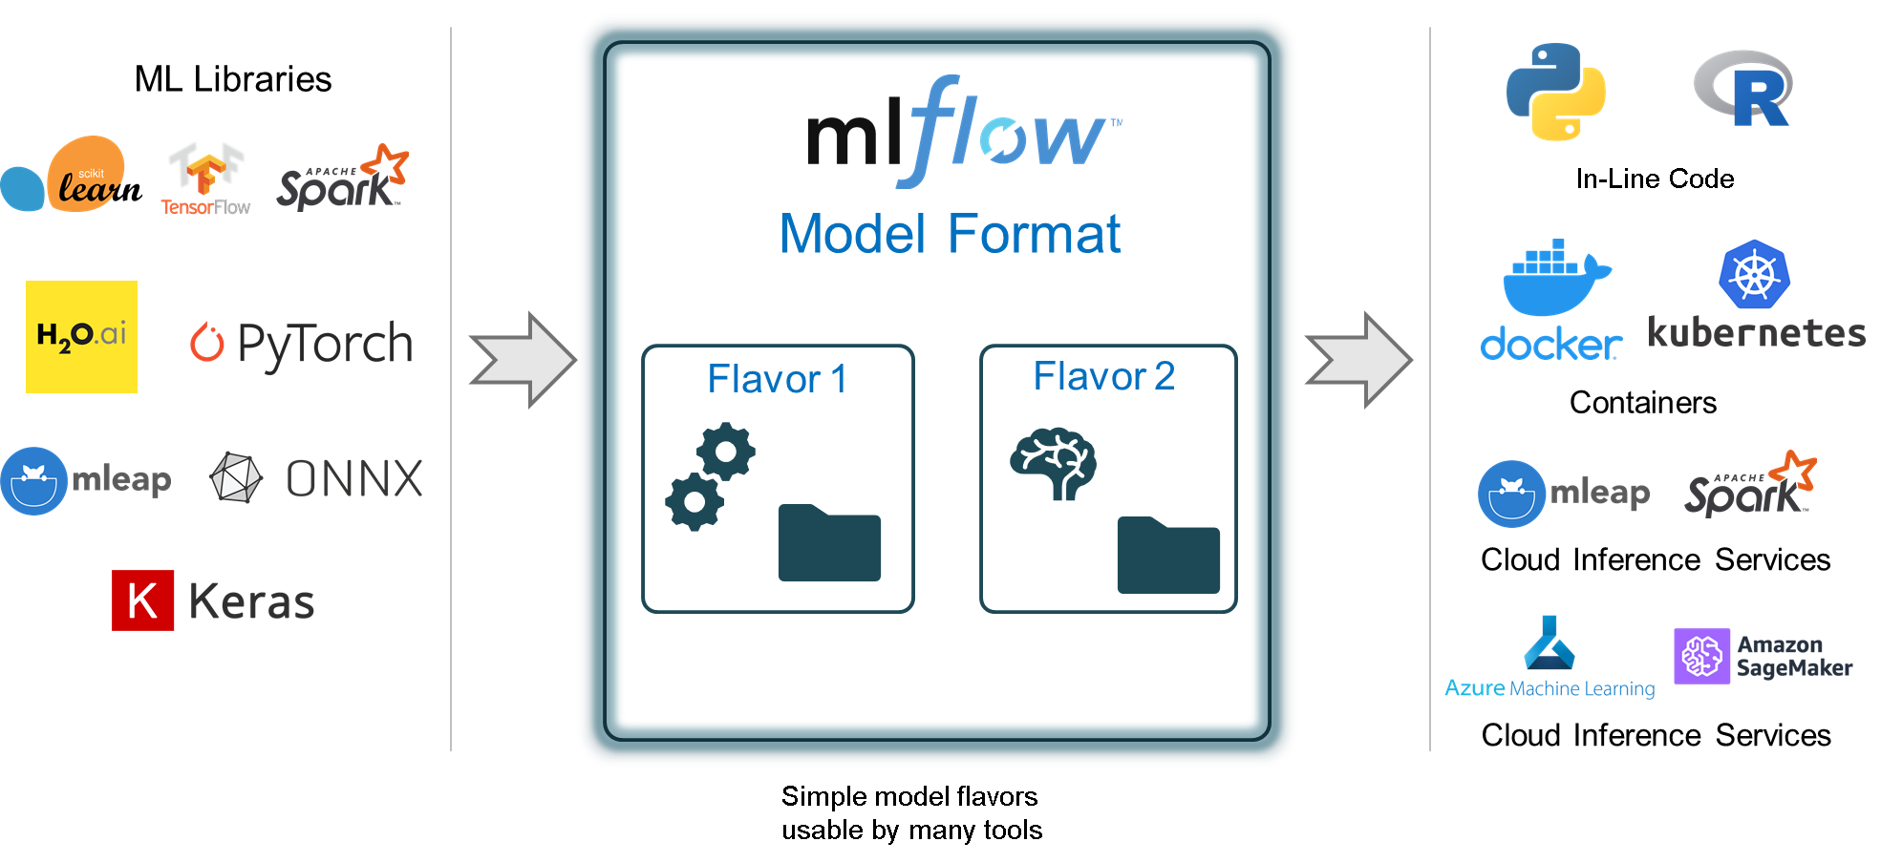
Mlflow Models

Slide 23
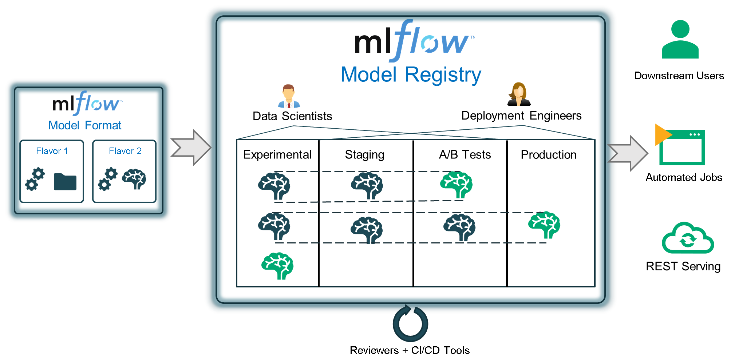
Mlflow Registry

Slide 24
Demo
# Enable MLflow Autologging
mlflow.keras.autolog()
X, y = get_training_data()opt = keras.optimizers.Adam(lr=params["learning_rate"],
beta_1=params["beta_1"],
beta_2=params["beta_2"],
epsilon=params["epsilon"]
model = Sequential()model.add(Dense(int(params["units"]), ...)
model.add(Dense(1))
model.compile(loss="mse", optimizer=opt)
rest = model.fit(X, y, epochs=50, batch_size=64, validation_split=.2)

Slide 25
Call to Action
To get started with mlflow, just pip install mlflow
Docs and Tutorials mlflow.org
Session materials and demo https://github.com/krsnagaraj/dataaisummit-mlflow
Connect with us
https://uk.linkedin.com/in/nagarajsengodan
https://www.linkedin.com/in/nitinrajs

Slide 26
Thank You

Slide 27

Feedback
Your feedback is important to us.
Don’t forget to rate and review the sessions.

